Slide 1
Goal:
Create a design tool for modular creation of the synthetic nervous system for legged animal with GUI
Hypothesis:
The synthetic nervous system could be decomposing into several functional subnetworks.
Functionality of units in the same layer acts the same.
Modular assembling of those functional subnetworks could replicate the original neurological characteristics.
Synergistic muscles sharing Ia interneuron and Renshaw cell.
Specific aims:
Aim 1 – Decompose the synthetic nervous system into several functional subnetworks: RG, PF, MN. Then reassemble them as a simple SNS to test if this modular created SNS could reproduce the same neurological behavior as previous models.
Aim 2 – Investigate the control strategies of biarticular muscle and how synergistic muscles cooperating in the sub-pattern formation layer. Also, determine the proprioceptor feedbacks involved in the individual motoneuron layer.
Aim 3 – Built the graphical user interface for assembling the functional subnetworks.

Slide 2
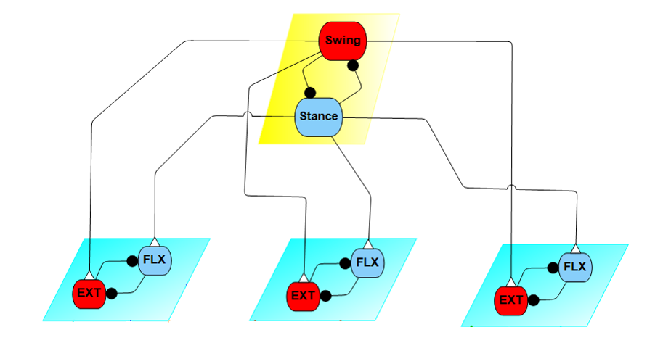
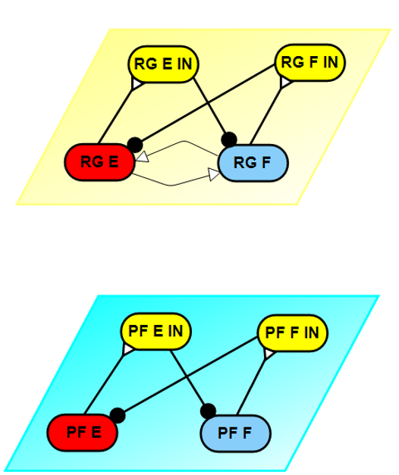
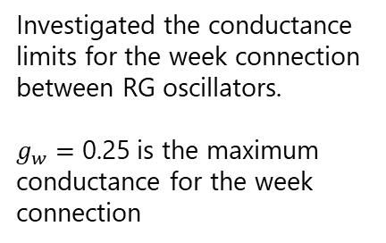
Recap previous meetings:
Tested stimulus to different PF layer
0.3
0.25
Investigated the conductance limits for the week connection between RG oscillators.
$g_{w}=$ 0.25 is the maximum conductance for the week connection
Tested stimulus to half-center oscillators

Slide 3
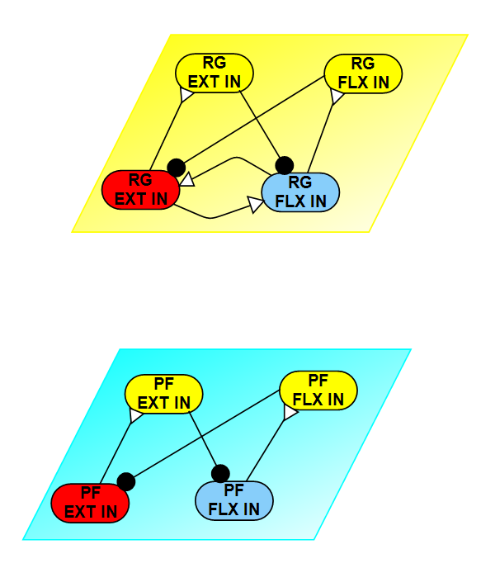
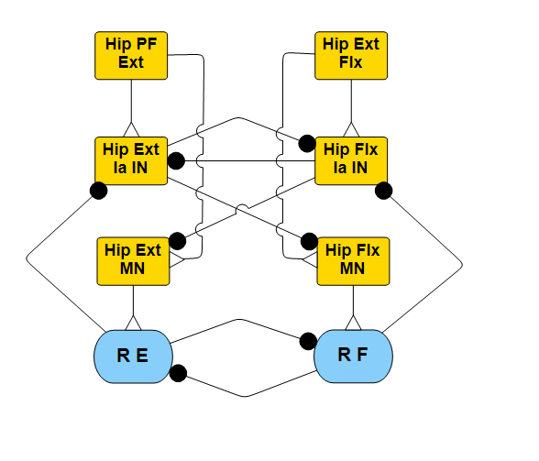

Recap previous meetings:
0.067
0.049
Distributed the CPG signal to MN integral layer.
Basic function of SNS has been replicate, need more work with feedbacks from muscle to do sanity with animal data.
Investigated the conductance limits between the RG and PF. ( $0.067<g_{c}<8.2$ )

Slide 4
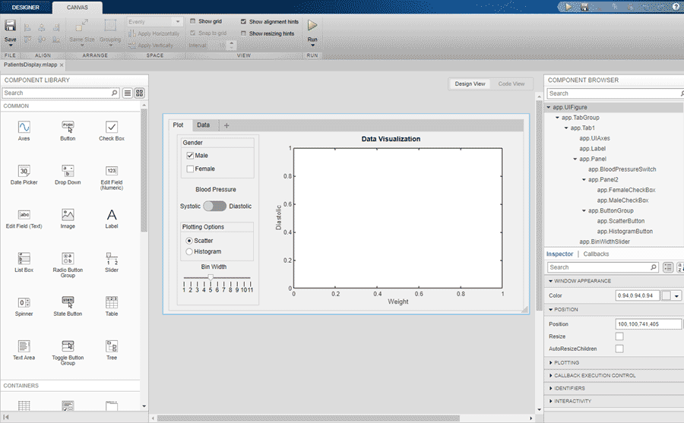
Design GUI:
Three different ways to build a graphic interface (GUI) in Matlab:
Code program to set up UI (Canvas, etc. which fletcher use)
GUIDE (Matlab old version, no longer update and will be removed)
App designer (New feature, could export as .exe)

Slide 5
Design GUI:
First, write the script for functional subnetwork contour or shape.
RG contour
PF+MN contour
Red are extensor oscillators, Blue are flexor oscillators, Cyan are interneurons, Yellow are motoneurons.

Slide 6
Design GUI:

Slide 7
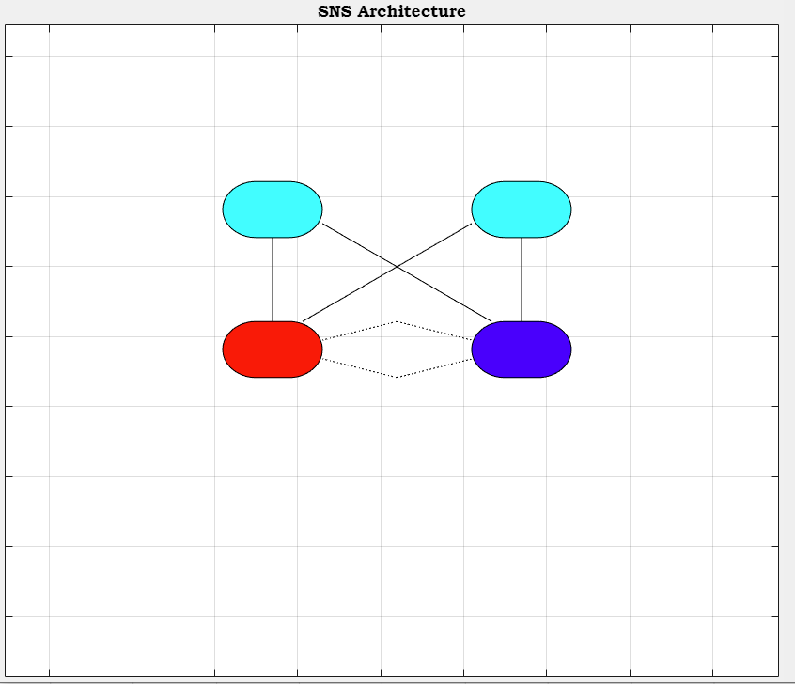
Design GUI Problems:
Limited mouse interaction, can’t right click, select.
Code not perfect compile with script, the markers shows error in the app designer. (Found solution.)
Can’t assign parameters since can’t select (Found solution).
Since the tool is relatively new, not much tutorial and online solutions.

Slide 8
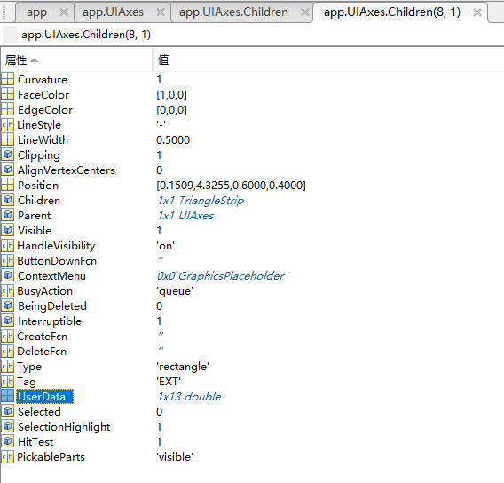
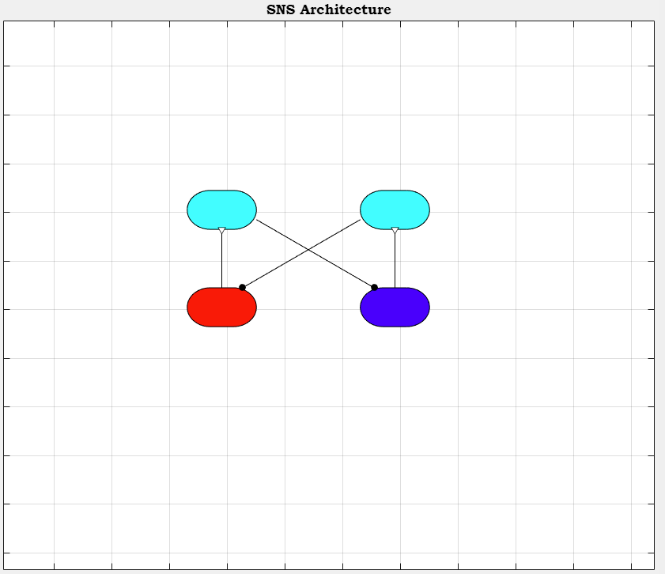
Design GUI :
Dive into source code and search properties:
The marker could set inside the callback codes,as:
app.UIAxes.Children(1).Marker = 'o';
app.UIAxes.Children(1).MarkerIndices = 2;
app.UIAxes.Children(1).MarkerFaceColor = 'k';
The neural parameter can compile with graphic nodes in User data of children class.

Slide 9
Design GUI :
Signal transmit through network and generates plots for membrane voltage.

Slide 10
Next steps:
Short term goal:
Find solution for drag and drop and other mouse interaction.
Visualize the connection links between functional subnetworks.
Flow the signal through a complete SNS and investigate.
Set up panel for parameter changing on the UI.
Long term goal:
Calculate feedbacks for each muscle.
Define the feedback signal in the muscle units and distribution.
Run the SNS with feedback and compare with animal data to do sanity check.
Setup experiment and get decent results for the journal paper.
Get the journal published.

